Slide 1
Logic expression normalizer
Object Oriented Language and Theory - Lab
Lecturer: Nguyen Thi Thu Trang, Ph.D.
June 2021

Slide 2
GROUP 3
Full name | Student ID | Assignment
Tran Trung Hieu | 20194764 | Package: column, table Controller and GUI: Main menu Report
To Xuan Hung | 20194772 | Package: minterm Controller and GUI: Input interface Report and Slides
Nguyen Tran Minh Tuan | 20194877 | Package: output Controller and GUI: Output interface Report

Slide 3
Problem statement
Normalize a logic expression using the implementation of the Quine-McCluskey method
The same expression can be implemented using fewer logic gates

Slide 4
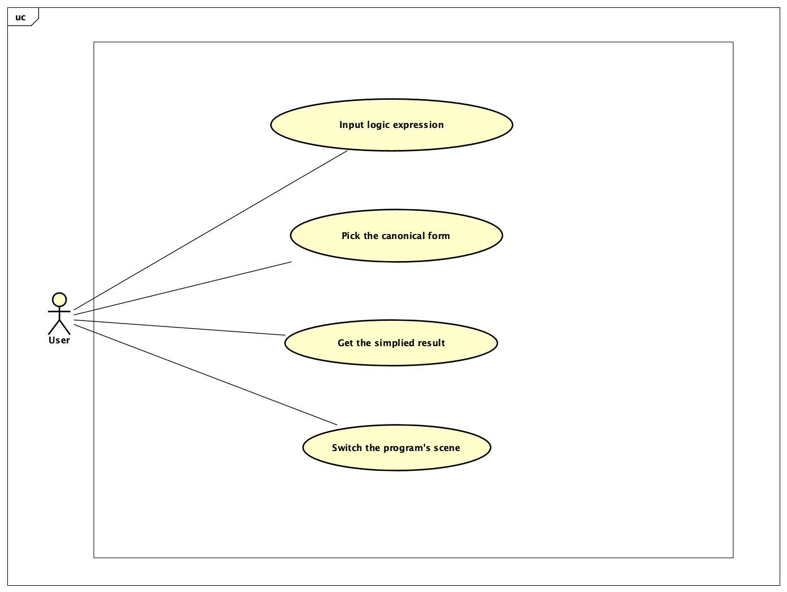
Use case diagram

Slide 5
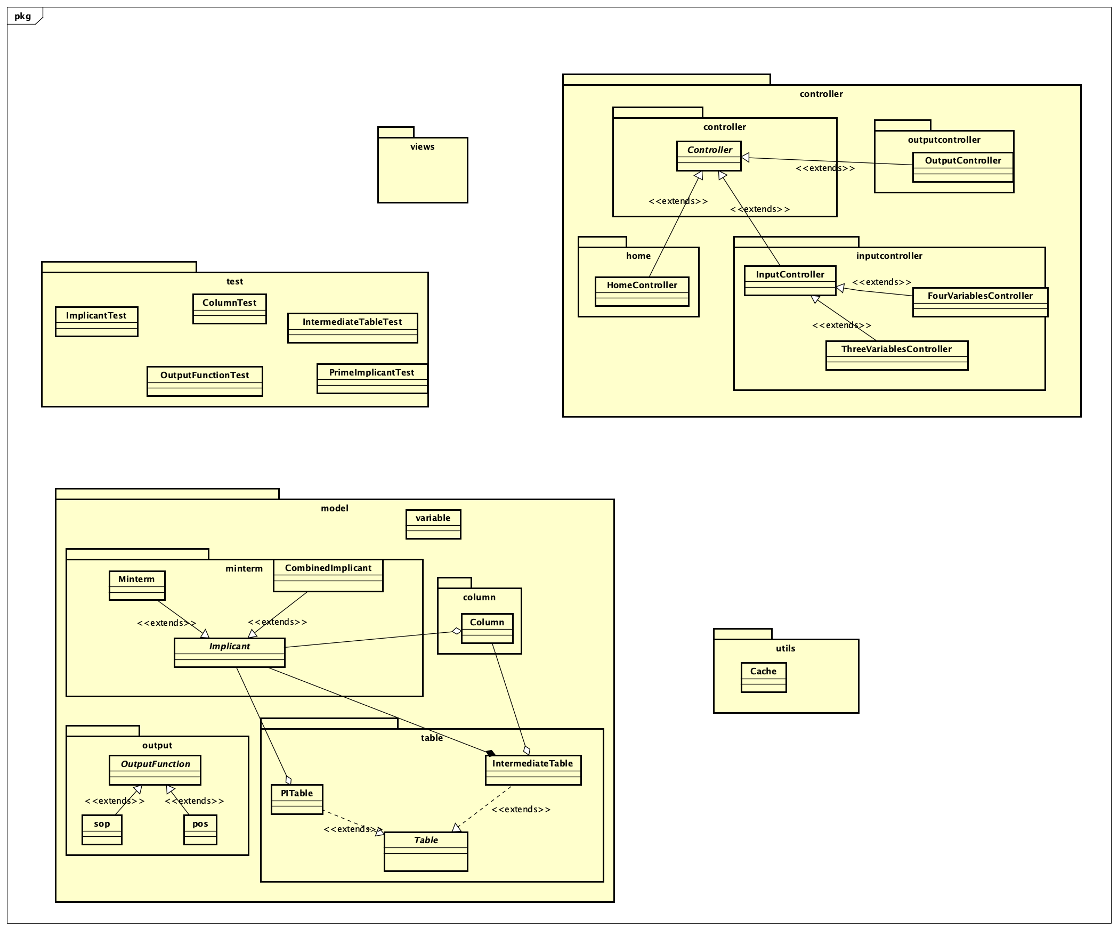
General class diagram

Slide 6
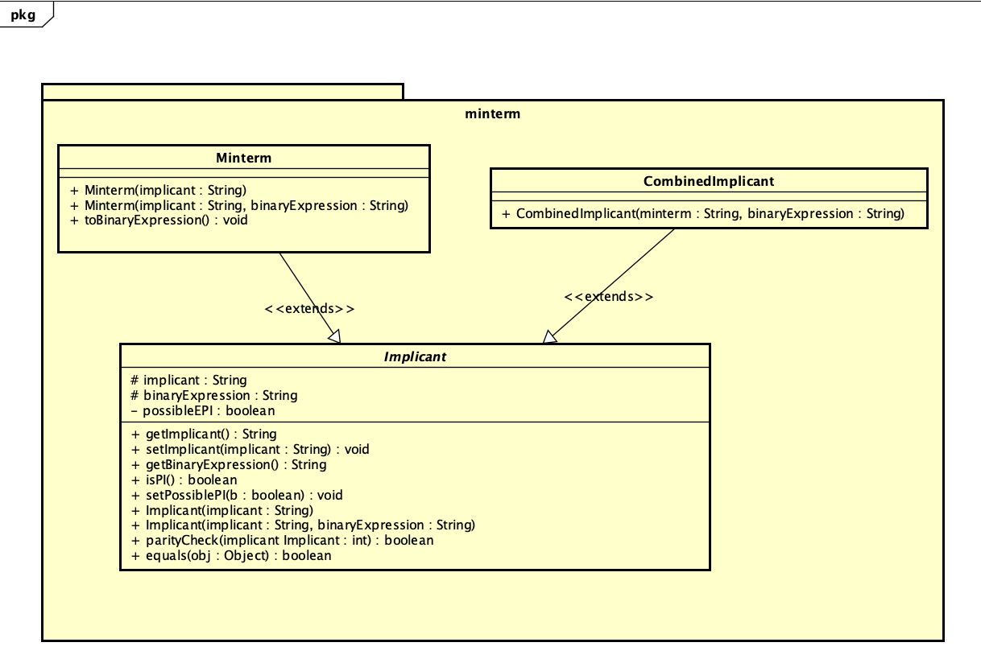
Minterm class diagram

Slide 7
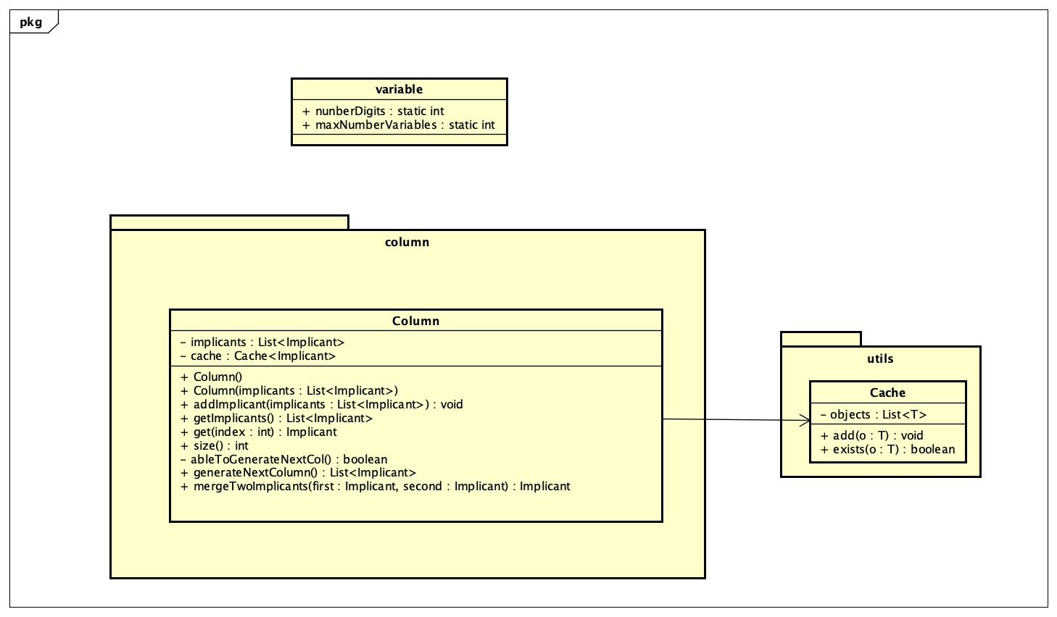
Column class diagram

Slide 8
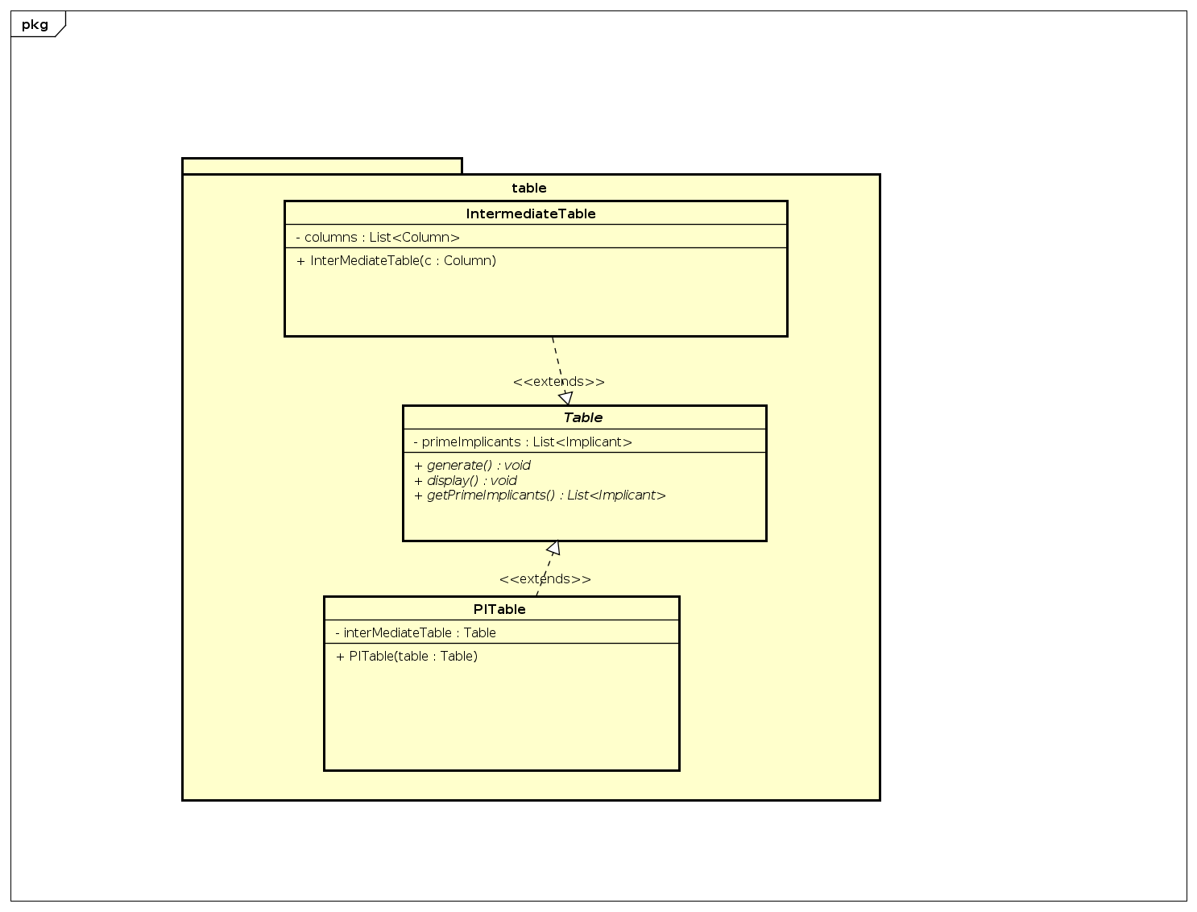
table class diagram

Slide 9
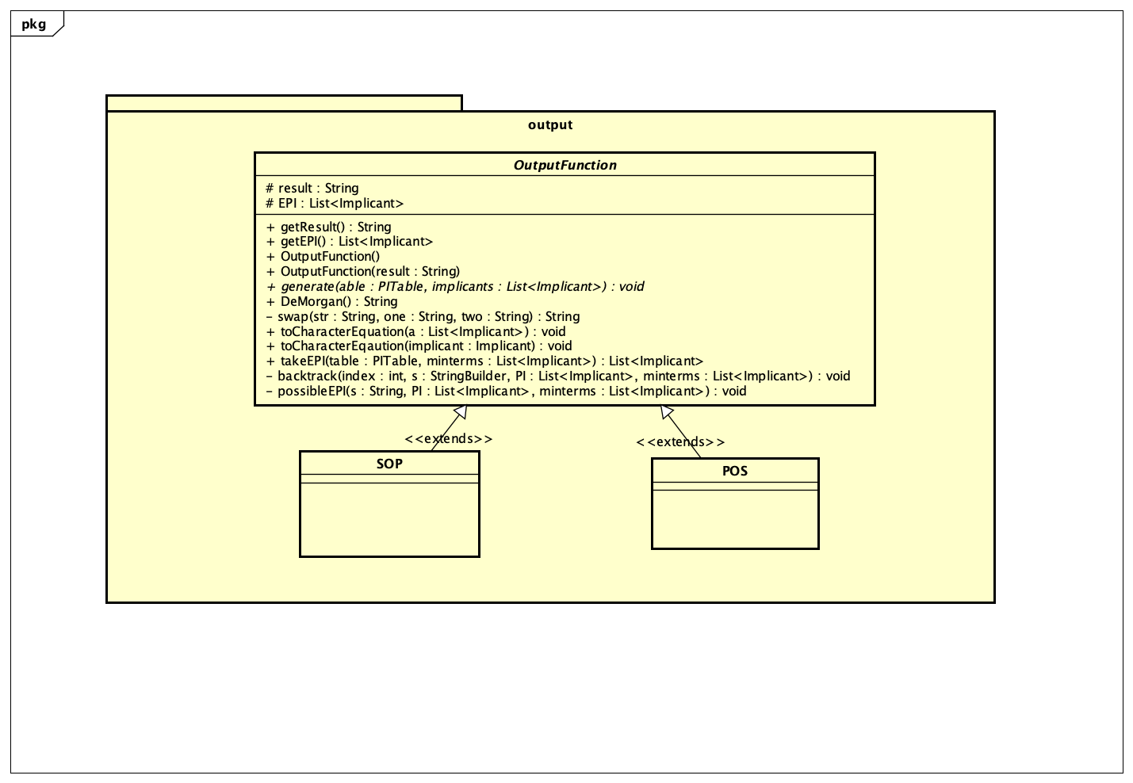
Output class diagram

Slide 10
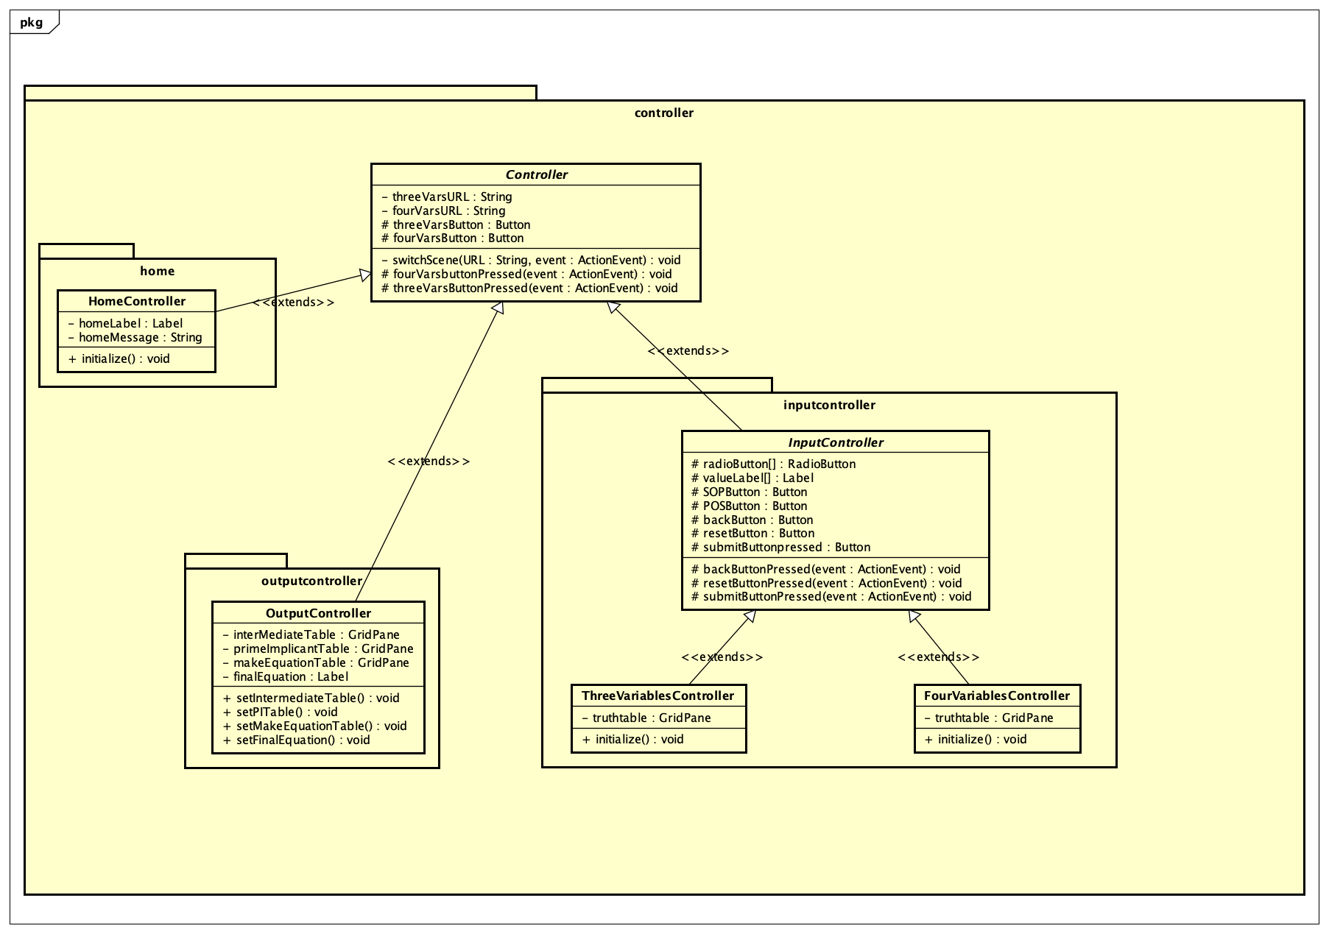
Controller class diagram

Slide 11
Explanation of oop design
A column possibly contains implicants, the intermediate table contains one or more columns.
The aggregation relationship is used among Implicant class, the Column class, the PITable and the IntermediateTable class
However, the IntermediateTable must contain at least one column, so the relationship between those two is a strong composite relationship

Slide 12
Explanation of oop design
The Implicant class is a parent class which is inherited by the Minterm class and CombinedImplicant class. All of the other classes interact with Implicant only so the true type is determined when the program is running → runtime polymorphism
The IntermediateTable and PITable both inherit the Table class
The SOP and POS class should inherit the OuputFunction

Slide 13
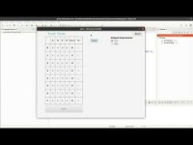
Application demonstration

Slide 14
Thanks

